Slide 1

DATABASE COURSE 2023/2024
SESSION 9

Slide 2
SESSION 9
RELATIONAL DATABASES BASICS
TABLES RELATIONSHIP
NORMALIZATION
RELATIONAL DATABASE CASE 1
RELATIONAL DATABASE CASE 2
RELATIONAL DATABASES CONSTRAINTS

Slide 3
RELATIONAL DATABASES BASICS
Definition
Cares the integrity of the data:
Completeness and consistency of the data
Safety of the data
RDBMS manage constraints
All related table should have a primary key constraint.
All reference to other tables should be specified with a foreign key constraint.
Any association between two entities is called relationship. There are three types of relationship:
One to One
One to Many or Many to One
Many to Many

Slide 4
SESSION 9
RELATIONAL DATABASES BASICS
TABLES RELATIONSHIP
NORMALIZATION
RELATIONAL DATABASE CASE 1
RELATIONAL DATABASE CASE 2
RELATIONAL DATABASES CONSTRAINTS

Slide 5

TABLES RELATIONSHIP
One to one
Such a relationship exists when each record of one table is related to only one record of the other table.

Slide 6
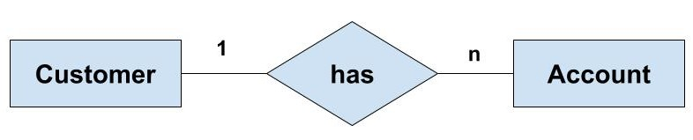
TABLES RELATIONSHIP
One to Many/Many to One
Such a relationship exists when each record of one table can be related to one or more than one record of the other table. This relationship is the most common relationship found.

Slide 7
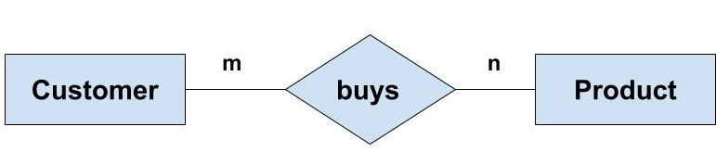
TABLES RELATIONSHIP
Many to Many
A many-to-many relationship can be seen as a two one-to-many relationship which is linked by a 'linking table' or 'associate table'.

Slide 8
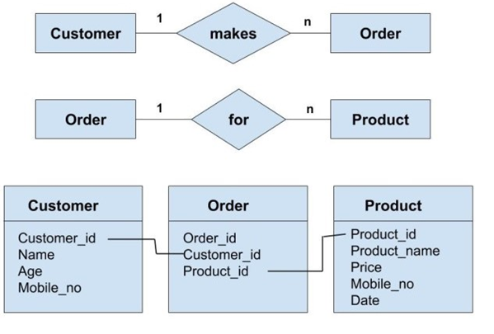
TABLES RELATIONSHIP
Many to Many(linking table)
We can have the 'Order' entity as a linking table which links the 'Customer' and 'Product' entity. We can break this many-to-many relationship in two one-to-many relationships.

Slide 9
SESSION 9
RELATIONAL DATABASES BASICS
TABLES RELATIONSHIP
NORMALIZATION
RELATIONAL DATABASE CASE 1
RELATIONAL DATABASE CASE 2
RELATIONAL DATABASES CONSTRAINTS

Slide 10
NORMALIZATION
Definition
Normalization is a process of organizing the data in database to avoid data redundancy.
It helps to achieve the integrity of the data.
There are four normal forms
First normal form(1NF)
Second normal form(2NF)
Third normal form(3NF)
Boyce & Codd normal form (BCNF)

Slide 11


NORMALIZATION
First Normal Form (1NF)
As per the rule of first normal form:
An attribute (column) of a table cannot hold multiple values. It should hold only atomic values.
mp_id | emp_name | emp_address | emp_mobile
101 | Herschel | New Delhi | 8912312390
102 | Jon | Kanpur | 8812121212 9900012222
103 | Ron | Chennai | 7778881212
104 | Lester | Bangalore | 9990000123 8123450987
emp_id | emp_name | emp_address | emp_mobile
101 | Herschel | New Delhi | 8912312390
102 | Jon | Kanpur | 8812121212
102 | Jon | Kanpur | 9900012222
103 | Ron | Chennai | 7778881212
104 | Lester | Bangalore | 9990000123
104 | Lester | Bangalore | 8123450987

Slide 12
NORMALIZATION
Second Normal Form (2NF)
A table is said to be in 2NF if both the following conditions hold:
Table is in 1NF (First normal form)
No non-prime attribute is dependent on the proper subset of any candidate key of table.
teacher_id | subject | teacher_age
111 | Maths | 38
111 | Physics | 38
222 | Biology | 38
333 | Physics | 40
333 | Chemistry | 40
teacher_id | teacher_age
111 | 38
222 | 38
333 | 40
teacher_id | subject
111 | Maths
111 | Physics
222 | Biology
333 | Physics
333 | Chemistry
Candidate Keys: {teacher_id, subject}

Slide 13

NORMALIZATION
Third Normal Form (3NF)
A table design is said to be in 3NF if both the following conditions hold:
Table must be in 2NF
Transitive functional dependency of non-prime attribute on any super key should be removed.
Project | ProjetTitle | Manager | Telf
132N4 | Manual Star | Garrison | 2756
132N6 | ISO Procs | Jacanda | 2954
132N7 | Web Page | Friedman | 2846
132P4 | Emp. Manual | Jones | 3102
132T6 | Star Prot. | Garrison | 2756
431Y7 | New Cat. | Jones | 3102
313M6 | Star Price | Vance | 3022
323H6 | System Ord | Jacanda | 2954
Project | ProjetTitle | Manager
132N4 | Manual Star | Garrison
132N6 | ISO Procs | Jacanda
132N7 | Web Page | Friedman
132P4 | Emp. Manual | Jones
132T6 | Star Prot. | Garrison
431Y7 | New Cat. | Jones
313M6 | Star Price | Vance
323H6 | System Ord | Jacanda
Manager | Telf
Garrison | 2756
Jacanda | 2954
Friedman | 2846
Jones | 3102
Vance | 3022

Slide 14
NORMALIZATION
Boyce Codd Normal Form (BCNF)
BCNF is stricter than 3NF. A table complies with BCNF if it is in 3NF and for every functional dependency X->Y, X should be the super key of the table.
emp_id | emp_country | emp_dept | dept_type | dept_no_of_emp
1001 | Austrian | Production and planning | D001 | 200
1001 | Austrian | stores | D001 | 250
1002 | American | design and technical support | D134 | 100
1002 | American | Purchasing department | D134 | 600

Slide 15
NORMALIZATION
Boyce Codd Normal Form (BCNF)
emp_id | emp_nationality
1001 | Austrian
1002 | American
emp_id | emp_dept
1001 | Production and planning
1001 | stores
1002 | design and technical support
1002 | Purchasing department
emp_dept | dept_type | dept_no_of_emp
Production and planning | D001 | 200
stores | D001 | 250
design and technical support | D134 | 100
Purchasing department | D134 | 600

Slide 16
SESSION 9
RELATIONAL DATABASES BASICS
TABLES RELATIONSHIP
NORMALIZATION
RELATIONAL DATABASE CASE 1
RELATIONAL DATABASE CASE 2
RELATIONAL DATABASES CONSTRAINTS

Slide 17
RELATIONAL DATABASES CASE 1
An International Brand wants to build a Relational Model for its sales.
The Brand owns several shops which are the only way to sell by the moment.
They want to register all the employees and their hiring dates.
They want to register all the sales done in each shop and also they want record the seller of each sale.
They also want to register all the offered products and the suppliers that supply each product.

Slide 18
RELATIONAL DATABASES CASE 1
Structure the data into entities
Shop
ShopName
Address
Telephone
Homepage
OpenningDate
Supplier
SupplierName
DocumentID
Telephone
Address
Product
ProductName
ProductType
Unit
Price
SupplierName
Employee
EmployeeName
EmployeeLastName
HiringDate
DocumentID
Sale
ProductName
EmployeeName
EmployeeLastName
ShopName
Date
Quantity

Slide 19
RELATIONAL DATABASES CASE 1
Primary Key: For each Table, stablish the column(s) that will identify one record
Shop
ShopID
ShopName
Address
Telephone
Homepage
OpenningDate
Supplier
SupplierID
SupplierName
DocumentID
Telephone
Address
Product
ProductID
ProductName
ProductType
Unit
Price
SupplierName
Employee
EmployeeID
EmployeeName
EmployeeLastName
HiringDate
DocumentID
Sale
SaleID
ProductName
EmployeeName
EmployeeLastName
ShopName
Date
Quantity

Slide 20
RELATIONAL DATABASES CASE 1
Foreign Key: For each Table, stablish the column(s) that can be reference for a Primary key from another tables
Shop
ShopID
ShopName
Address
Telephone
Homepage
OpenningDate
Supplier
SupplierID
SupplierName
DocumentID
Telephone
Address
Product
ProductID
ProductName
ProductType
Unit
Price
SupplierID
Employee
EmployeeID
EmployeeName
EmployeeLastName
HiringDate
DocumentID
Sale
SaleID
ProductID
EmployeeID
ShopID
Date
Quantity

Slide 21
RELATIONAL DATABASES CASE 1
Establish the relations. (1-N)
Supplier
SupplierID
SupplierName
DocumentID
Telephone
Address
Product
ProductID
ProductName
ProductType
Unit
Price
SupplierID
N
Sale
SaleID
ProductID
EmployeeID
ShopID
Date
Quantity
Employee
EmployeeID
EmployeeName
EmployeeLastName
HiringDate
DocumentID
1
1
N
Shop
ShopID
ShopName
Address
Telephone
Homepage
OpenningDate
N
1
N
N

Slide 22
RELATIONAL DATABASES CASE 1
Linking Table
Sale_Product
SaleID
ProductID
N
N
Supplier
SupplierID
SupplierName
DocumentID
Telephone
Address
Product
ProductID
ProductName
ProductType
Unit
Price
SupplierID
Sale
SaleID
ProductID
EmployeeID
ShopID
Date
Quantity
Employee
EmployeeID
EmployeeName
EmployeeLastName
HiringDate
DocumentID
1
1
1
1
Shop
ShopID
ShopName
Address
Telephone
Homepage
OpenningDate
N
1
N
N

Slide 23
SESSION 9
RELATIONAL DATABASES BASICS
TABLES RELATIONSHIP
NORMALIZATION
RELATIONAL DATABASE CASE 1
RELATIONAL DATABASE CASE 2
RELATIONAL DATABASES CONSTRAINTS

Slide 24
RELATIONAL DATABASES CASE 2
A university wants to register all the subjects in all careers offered.
The need includes to register the teachers as well as the students.
The university needs to register the hiring date of the teacher, the type of contract.
From the subjects they want to register the name, the year of the career, the credits.
A subject can use one classroom only and can be given by one teacher only. A teacher can give several subjects.
From the classroom they want to register the floor, a number, the capacity.

Slide 25
RELATIONAL DATA BASES CASE 2
Student
StudentID
AdmissionDate
ScolarShip
PersonID
School
SchoolID
SchoolName
Telephone
HomePage
Address
DeanPersonID
Career
CareerID
SchoolID
CareerName
Years
PriceByYear
Subject
SubjectID
CareerID
TeacherID
ClassRoomID
CourceName
Year
IsOptative
Credits
N
1
1
N
StudentSubject
IDStudentSubject
CourseID
StudentID
N
N
1
N
1
N
Person
PersonID
Name
LastName
DocID
Sex
BirthDate
Teacher
TeacherID
HiringDate
ContratType
PersonID
ClassRoom
ClassRoomID
Floor
Number
IsLaboratory
Capacity
1
1

Slide 26
SESSION 9
RELATIONAL DATABASES BASICS
TABLES RELATIONSHIP
NORMALIZATION
RELATIONAL DATABASE CASE 1
RELATIONAL DATABASE CASE 2
RELATIONAL DATABASES CONSTRAINTS

Slide 27
RELATIONAL DATABASES CONSTRAINTS
ALTER TABLE - PRIMARY KEY Syntax
MySQL/Oracle
ALTER TABLE table ADD CONSTRAINT ContraintName PRIMARY KEY (PKField1,PKField2,...)
MySQL/Oracle
ALTER TABLE table ADD PRIMARY KEY (PKField1,PKField2,...)

Slide 28



RELATIONAL DATABASES CONSTRAINTS
ALTER TABLE - PRIMARY KEY Example
BBDD/User: moviesmall
MySQL/Oracle
SELECT * FROM moviesmall;
MySQL/Oracle
INSERT INTO moviesmall VALUES (10920, 'Aliens',1990,7.6);
ROLLBACK;
MySQL/Oracle
ALTER TABLE moviesmall ADD CONSTRAINT pk_moviesmall PRIMARY KEY (ID);
MySQL/Oracle
INSERT INTO moviesmall VALUES (10920, 'Aliens',1990,7.6);
Notes:
MYSQL:
SHOW VARIABLES WHERE Variable_name='autocommit';
set autocommit=0/1
ORACLE:
show autocommit
SET autocommit off/on

Slide 29
RELATIONAL DATABASES CONSTRAINTS
CREATE TABLE – PRIMARY KEY Syntax
Oracle
CREATE TABLE table (PkField1 DataType CONSTRAINT ContraintName PRIMARY KEY, Field2 DataType, Field3 DataType);
MySQL/Oracle
CREATE TABLE table (PkField1 DataType PRIMARY KEY, Field2 DataType, Field3 DataType);
MySQL/Oracle
CREATE TABLE table (PkField1 DataType, Field2 DataType, Field3 DataType, PRIMARY KEY (PkField1) );
MySQL/Oracle
CREATE TABLE table (PkField1 DataType, Field2 DataType, Field3 DataType, CONSTRAINT ContraintName PRIMARY KEY (PkField1) );

Slide 30
RELATIONAL DATABASES CONSTRAINTS
CREATE TABLE – PRIMARY KEY Example
BBDD/User: mydata
MySQL
Oracle
CREATE TABLE car (
make VARCHAR(50),
model VARCHAR(100),
category VARCHAR(100),
year INTEGER,
CONSTRAINT pk_car PRIMARY KEY (make,model) );
CREATE TABLE car (
make VARCHAR2(50),
model VARCHAR(100),
category VARCHAR2(100),
year NUMBER,
CONSTRAINT pk_car PRIMARY KEY (make,model));

Slide 31


RELATIONAL DATABASES CONSTRAINTS
CREATE TABLE – PRIMARY KEY Example
BBDD/User: mydata
MySQL/Oracle
INSERT INTO car VALUES ('Fiat','124 Spider','Convertible',2019);
MySQL/Oracle
INSERT INTO car VALUES ('Fiat','124 Spider','Convertible',2020);

Slide 32
RELATIONAL DATABASES CONSTRAINTS
ALTER TABLE – FOREIGN KEY Syntax
MySQL/Oracle
ALTER TABLE table
ADD FOREIGN KEY (FKField) REFERENCES RefTable(RefField)
MySQL/Oracle
ALTER TABLE table
ADD CONSTRAINT ConstraintName
FOREIGN KEY (FKField) REFERENCES refTable(RefField)

Slide 33
RELATIONAL DATABASES CONSTRAINTS
ALTER TABLE – FOREIGN KEY Example
BBDD/User: mydata
MySQL
Oracle
DROP TABLE car;
CREATE TABLE car (
make VARCHAR(50),
model VARCHAR(100),
idcategory INTEGER,
year INTEGER,
CONSTRAINT pk_car PRIMARY KEY (make,model));
CREATE TABLE category (
id INTEGER,
description VARCHAR(100),
CONSTRAINT pk_category PRIMARY KEY (id));
DROP TABLE car;
CREATE TABLE car (
make VARCHAR2(50),
model VARCHAR2(100),
idcategory NUMBER,
year NUMBER,
CONSTRAINT pk_car PRIMARY KEY (make,model));
CREATE TABLE category (
id NUMBER,
description VARCHAR2(100),
CONSTRAINT pk_category PRIMARY KEY (id));

Slide 34

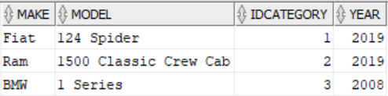
RELATIONAL DATABASES CONSTRAINTS
ALTER TABLE – FOREIGN KEY Example
BBDD/User: mydata
MySQL/Oracle
INSERT INTO category VALUES (1,'Convertible');
INSERT INTO category VALUES (2,'Pickup');
INSERT INTO car VALUES ('Fiat','124 Spider',1,2019);
INSERT INTO car VALUES ('Ram','1500 Classic Crew Cab',2,2019);
INSERT INTO car VALUES ('BMW','1 Series',3,2008);
Category
Car
Notes:
Probar la creación de la FK solo con los 2 primeros registros de car

Slide 35
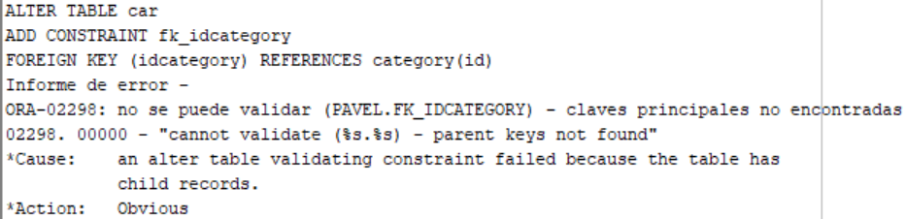
RELATIONAL DATABASES CONSTRAINTS
ALTER TABLE – FOREIGN KEY Example
BBDD/User: mydata
MySQL/Oracle
ALTER TABLE car ADD CONSTRAINT fk_idcategory
FOREIGN KEY (idcategory) REFERENCES category(id);
MySQL/Oracle
TRUNCATE TABLE car;
TRUNCATE TABLE category;

Slide 36

RELATIONAL DATABASES CONSTRAINTS
ALTER TABLE – FOREIGN KEY Example
BBDD/User: mydata
MySQL/Oracle
ALTER TABLE car ADD CONSTRAINT fk_idcategory
FOREIGN KEY (idcategory) REFERENCES category(id);
MySQL/Oracle
INSERT INTO category VALUES (1,'Convertible');
INSERT INTO category VALUES (2,'Pickup');
INSERT INTO car VALUES ('Fiat','124 Spider',1,2019);
INSERT INTO car VALUES ('Ram','1500 Classic Crew Cab',2,2019);
Category
Car

Slide 37
RELATIONAL DATABASES CONSTRAINTS
ALTER TABLE – FOREIGN KEY Example
BBDD/User: mydata
Category
Car
MySQL/Oracle
INSERT INTO car VALUES ('BMW','1 Series',3,2008);
Notes:
¿Qué pasa si borramos category (tener en cuenta que car tiene una fk hacia la tabla)? -> NO Borra
¿Qué pasa si

Slide 38
RELATIONAL DATABASES CONSTRAINTS
CREATE TABLE – FOREIGN KEY Syntax
Oracle
CREATE TABLE table (Field1 DataType PRIMARY KEY, Field2 DataType CONSTRAINT ConstraintName REFERENCES RefTable(RefField), Field3 DataType)
MySQL/Oracle
CREATE TABLE table (Field1 DataType PRIMARY KEY, Field2 DataType, ...,
FOREIGN KEY (Field2) REFERENCES RefTable(RefField ))
MySQL/Oracle
CREATE TABLE table (Field1 DataType, Field2 DataType, ...,
CONSTRAINT Constraint1Name PRIMARY KEY (Field1),
CONSTRAINT Constraint2Name FOREIGN KEY (Field2) REFERENCES RefTable(RefField ))

Slide 39
RELATIONAL DATABASES CONSTRAINTS
CREATE TABLE – FOREIGN KEY Example
BBDD/User: mydata
MySQL
Oracle
CREATE TABLE mom (id INTEGER,
name VARCHAR(30),
CONSTRAINT pk_mom PRIMARY KEY (id));
CREATE TABLE child (id INTEGER, momid INTEGER,
name VARCHAR(30),
CONSTRAINT pk_child PRIMARY KEY (id),
CONSTRAINT fk_mom FOREIGN KEY (momid) REFERENCES mom(id) );
CREATE TABLE mom (id NUMBER,
name VARCHAR2(30),
CONSTRAINT pk_mom PRIMARY KEY (id));
CREATE TABLE child (id NUMBER,
momid NUMBER,
name VARCHAR2(30),
CONSTRAINT pk_child PRIMARY KEY (id),
CONSTRAINT fk_mom FOREIGN KEY (momid) REFERENCES mom(id) );

Slide 40

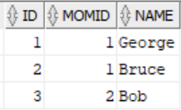
RELATIONAL DATABASES CONSTRAINTS
CREATE TABLE – FOREIGN KEY Example
BBDD/User: mydata
MySQL/Oracle
INSERT INTO mom VALUES (1, 'Adele');
INSERT INTO mom VALUES (2, 'Amy');
INSERT INTO child VALUES (1,1,'George');
INSERT INTO child VALUES (2,1,'Bruce');
INSERT INTO child VALUES (3,2,'Bob');
Mom
Child
MySQL/Oracle
INSERT INTO child VALUES (4,3,'John');

Slide 41
RELATIONAL DATABASES CONSTRAINTS
ACTIVATE/DEACTIVATE CONSTRAINTS
MySQL – Unique KEYS
MySQL – Foreign KEYS
SET unique_checks=0;
SET unique_checks=1;
SET foreign_key_checks=0;
SET foreign_key_checks=1;
Oracle
ALTER TABLE table
DISABLE CONSTRAINT ConstraintName;
ALTER TABLE table
ENABLE CONSTRAINT ConstraintName;

Slide 42
RELATIONAL DATABASES CONSTRAINTS
DROP PRIMARY KEY CONSTRAINT Syntax
MySQL/Oracle
Oracle
ALTER TABLE table
DROP PRIMARY KEY
ALTER TABLE table
DROP CONSTRAINT ConstraintName
DROP FOREIGN KEY CONSTRAINT Syntax
MySQL
Oracle
ALTER TABLE table
DROP FOREIGN KEY ConstraintName
ALTER TABLE table
DROP CONSTRAINT ConstraintName

